Slide 1
Microsoft Ignite recap – BI & DWH
Data Platform
Azure Synapse Analytics (preview)
Azure Data Factory Wrangling Dataflows (preview)
SQL Server 2019 GA
Enterprise Power BI
Enterprise information management capabilities
Large models in Power BI
XMLA write endpoint snart i preview
Power BI Dataflows nyheder
Øvrige Power Platform
Microsoft Flow -> Power Automate
UI Flows (RPA)
Power Virtual Agents
ALM Pipelines i Power BI
Opgrader Power BI workspace fra v1 til v2
Decomposition Tree i Power BI
Bedre Teams og Power BI integration

Slide 2
Modernizing your Data Warehouse with Azure Synapse Analytics
Matthew Hicks
Program Manager, Azure Data
BRK3224

Slide 3
Azure Synapse Analytics
Limitless analytics service with unmatched time to insight
Azure Synapse is Azure SQL Data Warehouse evolved—blending big data, data warehousing, and data integration into a single service for end-to-end analytics at cloud scale.

Slide 4
This is a result of businesses being forced to maintain two critical, yet independent analytics systems
Big Data
Relational Data
Ease of use
Fast exploration
Quick to start
Proven security
Airtight privacy
Dependable performance
OR
Data Lake
Data Warehouse
Welcome to limitless
All-in-one speed, flexibility, security, & dependability

Slide 5
Azure brings these two worlds together, in a single service
Ease of use
Fast exploration
Quick to start
Proven security
Airtight privacy
Dependable performance
Welcome to Azure Synapse Analytics

Slide 6

Azure Synapse Analytics
Limitless analytics service with unmatched time to insight
Artificial Intelligence / Machine Learning / Internet of Things
Intelligent Apps / Business Intelligence
Designed for analytics workloads at any scale
Azure Synapse
SaaS developer experiences for code free and code first
Experience
Azure Synapse Studio
Platform
Multiple languages suited to different analytics workloads
MANAGEMENT
Languages
SQL
Python
.NET
Java
Scala
R
Integrated analytics runtimes available provisioned and serverless on-demand
SQL Analytics offering T-SQL for batch, streaming and interactive processing
Spark for big data processing with Python, Scala, R and .NET
SECURITY
Form Factors
PROVISIONED
ON-DEMAND
MONITORING
Analytics Runtimes
SQL
METASTORE
DATA INTEGRATION
Integrated platform services for, management, security, monitoring, and metastore
Azure
Data Lake Storage
Common Data Model
Enterprise Security
Optimized for Analytics
Data lake integrated and Common Data Model aware

Slide 7
Modernizing your Data Warehouse

Slide 8
Solution scenarios
Big data and advanced analytics
SQL
Modern data warehousing
Advanced analytics
Real-time analytics
“We want to integrate all our data—including Big Data—with our data warehouse”
“We’re trying to predict when our customers churn”
“We’re trying to get insights from our devices in real-time”

Slide 9
Modern data warehousing
Canonical operations
Load and ingest
Prepare and analyze
Serve and visualize
A
B
C

Slide 10


Analytics using Azure Synapse
Ingest and store
data from multiple sources
Prepare your data
Analyze the
prepared data
Serve your data with high concurrency support
Build BI dashboards and reports
Azure Synapse
Experience
Azure Synapse Studio
On-premises data
Platform
MANAGEMENT
Languages
SQL
Python
.NET
Java
Scala
R
SECURITY
Form Factors
Power BI
PROVISIONED
ON-DEMAND
Cloud data
MONITORING
Analytics Runtimes
SQL
METASTORE
Azure Machine Learning
DATA INTEGRATION
SaaS data
Azure
Data Lake Storage Gen2
Common Data Model
Enterprise Security
Optimized for Analytics

Slide 11

Synapse Studio makes modern data warehouse solution-building easier than ever!
Synapse Studio combines ingestion, preparation, analysis, and serving.
Develop notebooks, SQL scripts, pipelines, PowerBI reports, and more… all within one experience.
Solution-level authoring and monitoring in a single pane of glass.
Spark and SQL can operate on the same data. No need to duplicate.

Slide 12
Analytics using Azure Synapse
Ingest and store
data from multiple sources
Prepare your data
Analyze the
prepared data
Serve your data with high concurrency support
Build BI dashboards and reports
Azure Synapse
Experience
Azure Synapse Studio
On-premises data
Platform
MANAGEMENT
Languages
SQL
Python
.NET
Java
Scala
R
SECURITY
Form Factors
Power BI
PROVISIONED
ON-DEMAND
Cloud data
MONITORING
Analytics Runtimes
SQL
METASTORE
Azure Machine Learning
DATA INTEGRATION
SaaS data
Azure
Data Lake Storage Gen2
Common Data Model
Enterprise Security
Optimized for Analytics

Slide 13


Ingesting, storing, and exploring your data
Leverage 90+ connectors to bring in your data
Ingest, store, and explore structured and unstructured data
1. Copy wizard
2. Explore
Azure Storage (Blob)
Data Lake Storage Gen2
Azure Synapse workspace
Container
File system
Parquet files
Parquet files
SQL On-demand

Slide 14
Analytics using Azure Synapse
Ingest and store
data from multiple sources
Prepare your data
Analyze the
prepared data
Serve your data with high concurrency support
Build BI dashboards and reports
Azure Synapse
Experience
Azure Synapse Studio
On-premises data
Platform
MANAGEMENT
Languages
SQL
Python
.NET
Java
Scala
R
SECURITY
Form Factors
Power BI
PROVISIONED
ON-DEMAND
Cloud data
MONITORING
Analytics Runtimes
SQL
METASTORE
Azure Machine Learning
DATA INTEGRATION
SaaS data
Azure
Data Lake Storage Gen2
Common Data Model
Enterprise Security
Optimized for Analytics

Slide 15
Preparing your data
Several options for data preparation, including:
Data Flow (code-free)
Spark notebooks or job definitions
SQL queries
Azure Synapse workspace
Dataflow or
Notebook/Job on Spark
Database (Spark)
Data Lake Storage Gen2
SQL Script
on SQL On-demand
Database (SQL OD)
File system
or
Parquet files
or
SQL Script
on SQL Analytics
Database (SQL pool)

Slide 16
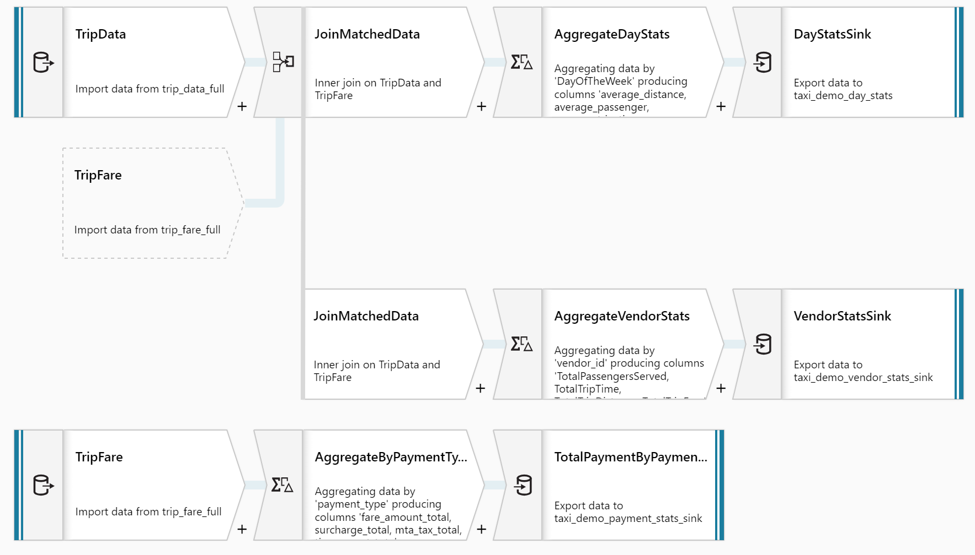
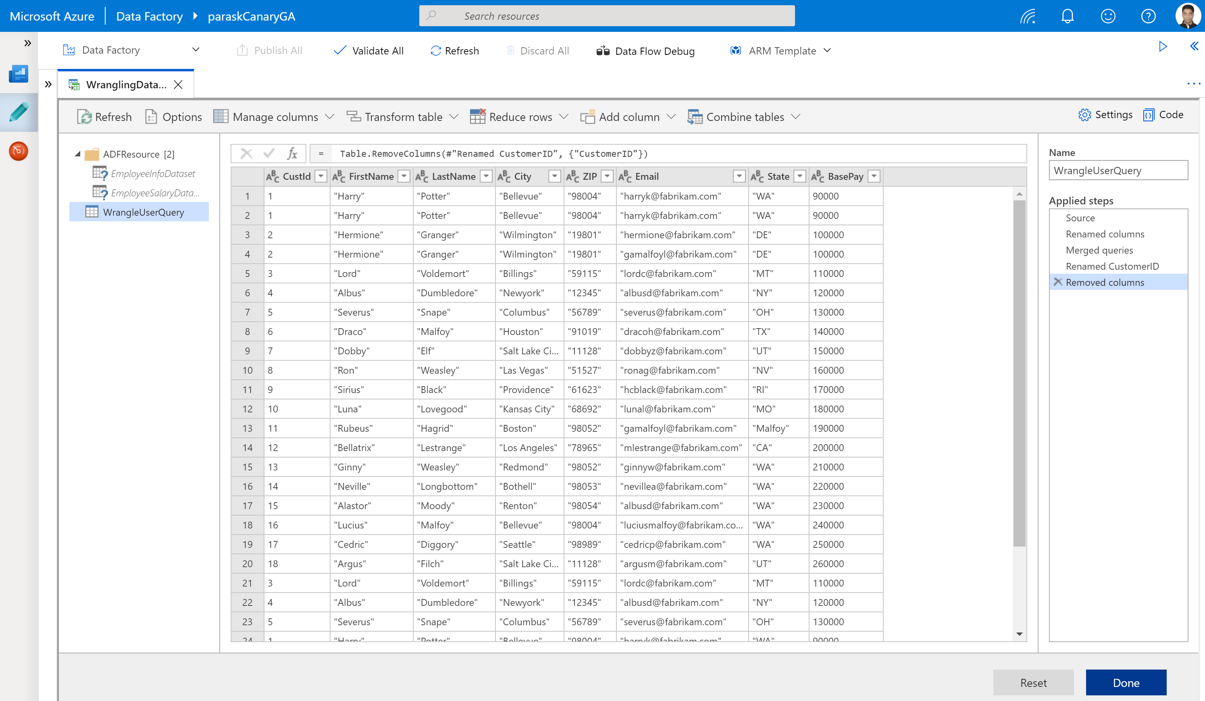
Code-free prepare & transform data
Mapping dataflow
Code free data transformation @scale
Wrangling dataflow
Code free data preparation @scale

Slide 17
Ingest, store, explore, and prepare your data Demo

Slide 18
Analytics using Azure Synapse
Ingest and store
data from multiple sources
Prepare your data
Analyze the
prepared data
Serve your data with high concurrency support
Build BI dashboards and reports
Azure Synapse
Experience
Azure Synapse Studio
On-premises data
Platform
MANAGEMENT
Languages
SQL
Python
.NET
Java
Scala
R
SECURITY
Form Factors
Power BI
PROVISIONED
ON-DEMAND
Cloud data
MONITORING
Analytics Runtimes
SQL
METASTORE
Azure Machine Learning
DATA INTEGRATION
SaaS data
Azure
Data Lake Storage Gen2
Common Data Model
Enterprise Security
Optimized for Analytics

Slide 19
Analyze your data
Azure Synapse workspace
Database (Spark)
Table1
Database (SQL pool)
Notebook
Table3
Table2

Slide 20
Analytics using Azure Synapse
Ingest and store
data from multiple sources
Prepare your data
Analyze the
prepared data
Serve your data with high concurrency support
Build BI dashboards and reports
Azure Synapse
Experience
Azure Synapse Studio
On-premises data
Platform
MANAGEMENT
Languages
SQL
Python
.NET
Java
Scala
R
SECURITY
Form Factors
Power BI
PROVISIONED
ON-DEMAND
Cloud data
MONITORING
Analytics Runtimes
SQL
METASTORE
Azure Machine Learning
DATA INTEGRATION
SaaS data
Azure
Data Lake Storage Gen2
Common Data Model
Enterprise Security
Optimized for Analytics

Slide 21
Serving and visualizing your data
Azure Synapse workspace
PowerBI workspace
Database (SQL pool)
Reports
Tables
Datasets

Slide 22
Microsoft Power BI: Roadmap for Enterprise Information Management
Adi Regev
Principal GPM Power BI
Anton Fritz
Senior PM Power BI
BRK3207

Slide 23
EIM - Empowers you to do more with your data
Data reuse
& discovery
Data lineage
& impact analysis
Data governance
& protection
EIM
Organic growth of
Power BI in orgs
Managing Advanced
Enterprise Analytics Apps
Data protection
Enterprise BI needs
Certify, discover and reuse data assets
Enhanced Native & external catalog experiences
Gain confidence in my data
Increase troubleshooting efficiency
Analyze impact
Manage apps & avoid data duplication
Leverage for Documentation & training
Classify & Protect organizational data
Real-time policy enforcement on data in Power BI
Gain oversight on sensitive data in Power BI tenant
Comply with privacy and regulatory requirements

Slide 24
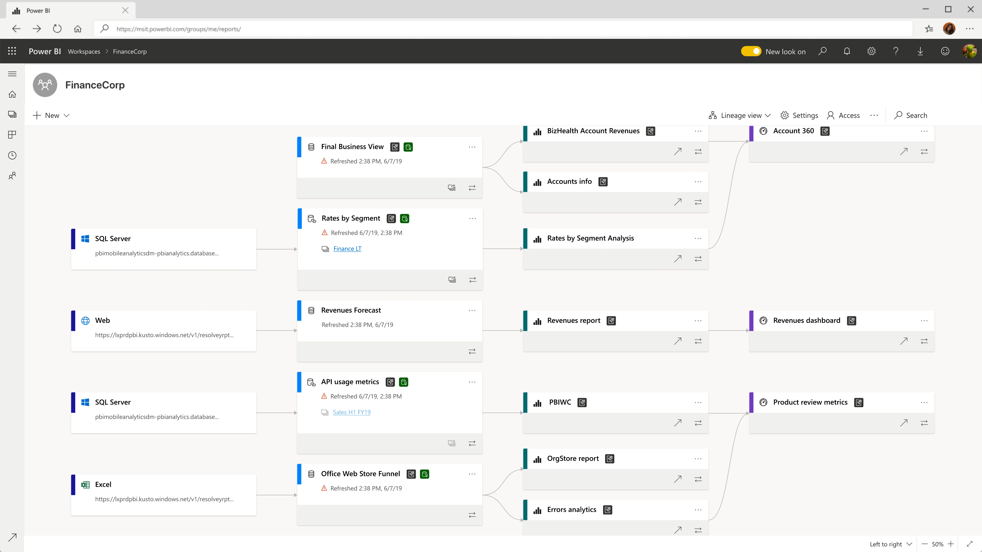
Coming next – impact analysis cross workspaces
Add 2 more images on click
Get a cross workspaces view of your data to understand dependencies and analyze impact

Slide 25
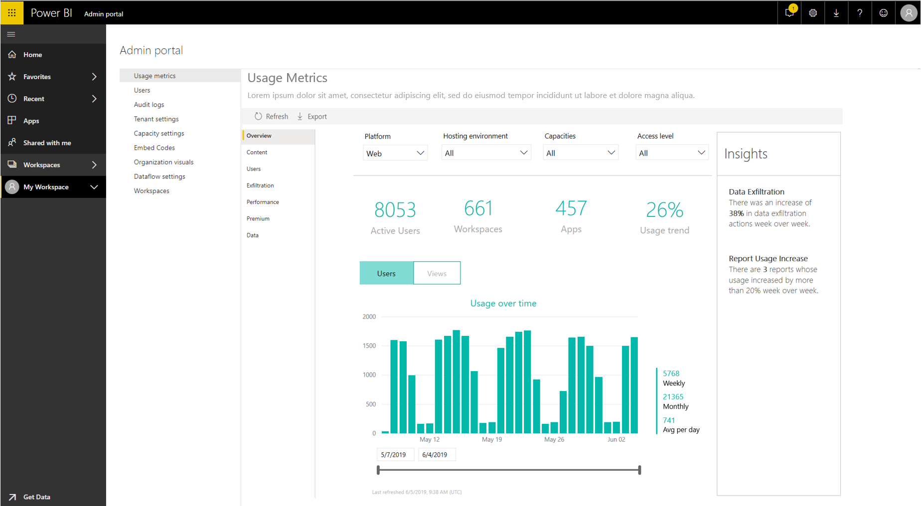
Coming Soon: Admin Usage Metrics for Power BI
Usage for core artifacts:
Dashboards, reports, datasets, workspaces
Information protection coverage
Custom visual usage
Data exportable to Excel

Slide 26
Power BI helps protect your data
Protect data within Power BI
Access permissions, row-level security, encrypted data at rest
New – Bring your own encryption key
Admin Oversight
Audit logs, Usage metrics, Admin APIs, etc. [Existing]
Near term roadmap - Admin oversight over sensitive data inventory and consumption
New – Protection reporting in Power BI & Security investigation capabilities leveraging Microsoft Cloud App Security
New – Monitor & protect user activity on sensitive data in real time
New at Ignite - Real time session monitoring and risk remediation leveraging Microsoft’s cloud app security
New – Protect data outside of Power BI
New at Ignite- Classify and label sensitive in Power BI leveraging the taxonomy and policies used in Office 365 apps like Excel, PowerPoint and Outlook

Slide 27
Power BI helps protect your data
Protect data within Power BI
Access permissions, row-level security, encrypted data at rest
New – Bring your own encryption key
Admin Oversight
Audit logs, Usage metrics, Admin APIs, etc. [Existing]
Near term roadmap - Admin oversight over sensitive data inventory and consumption
New - Security investigation capabilities leveraging Microsoft Cloud App Security
New – Monitor & protect user activity on sensitive data in real time
New at Ignite - Real time session monitoring and risk remediation leveraging Microsoft’s cloud app security
New – Protect data outside Power BI
New at Ignite- Classify and label sensitive in Power BI leveraging the taxonomy and policies used in Office 365 apps like Excel, PowerPoint and Outlook

Slide 28
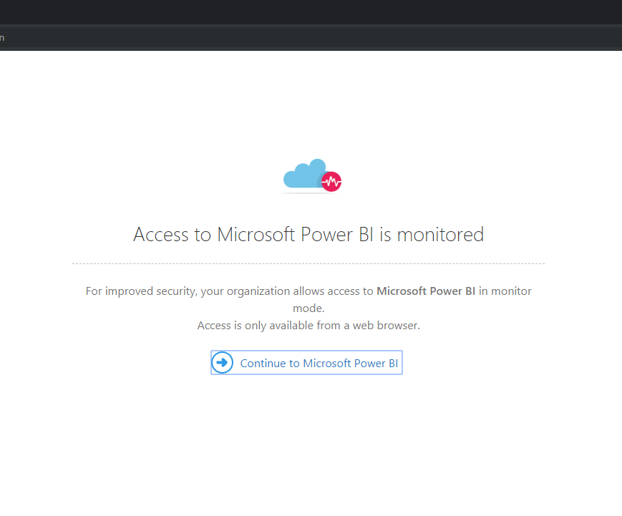
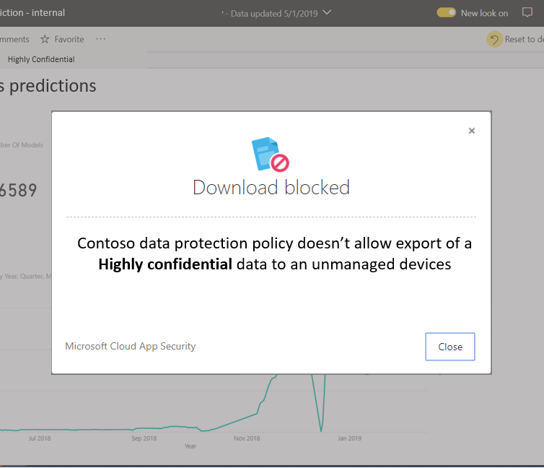
Leverage labels to protect sensitive data exfiltration
Security Admins can use Microsoft Cloud App Security to monitor and control risky Power BI sessions in real-time
e.g., block download of a report with sensitive label

Slide 29
Power BI helps protect your data
Protect data within Power BI
Access permissions, row-level security, encrypted data at rest
New – Bring your own encryption key
Admin Oversight
Audit logs, Usage metrics, Admin APIs, etc. [Existing]
Near term roadmap - Admin oversight over sensitive data inventory and consumption
New - Security investigation capabilities leveraging Microsoft Cloud App Security
New – Monitor & protect user activity on sensitive data in real time
New at Ignite - Real time session monitoring and risk remediation leveraging Microsoft’s cloud app security
New – Protect data outside Power BI
New at Ignite- Classify and label sensitive in Power BI leveraging the taxonomy and policies used in Office 365 apps like Excel, PowerPoint and Outlook

Slide 30
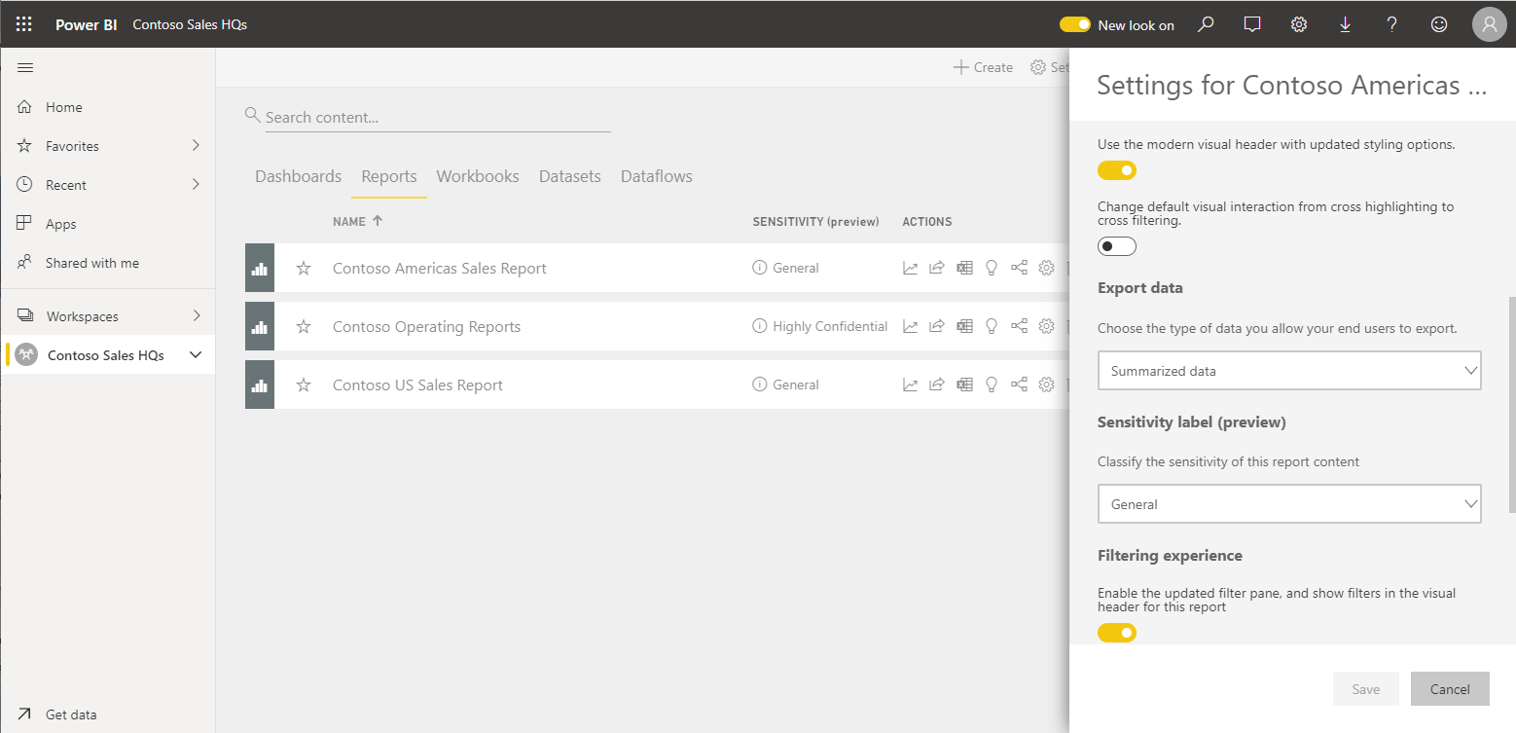
Classify and label Power BI artifacts with sensitivity labels
Data owners apply Microsoft Information Protection (MIP) sensitivity labels for datasets, reports, dashboards and dataflows.
These are the same sensitivity labels that can be used to classify and label Office 365 files, like Excel, Power Point and Word and emails in Exchange.

Slide 31
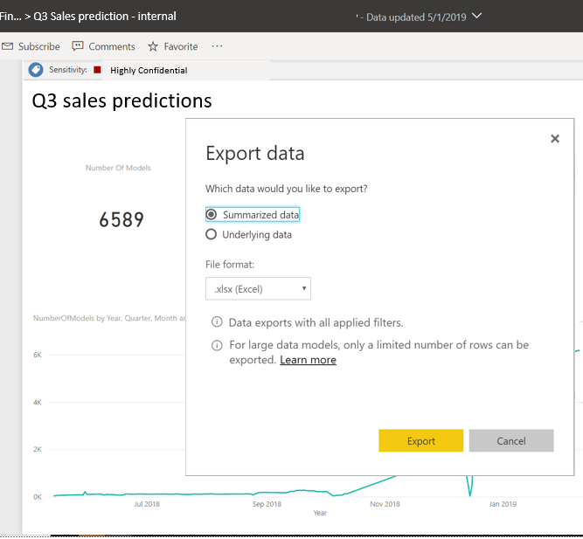
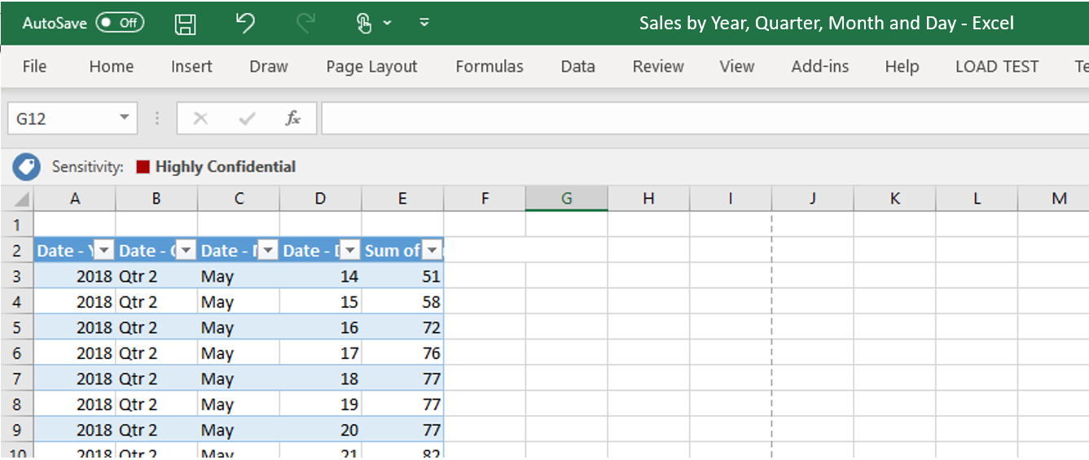
Label and Protect data exported from Power BI to files
Extend protection and governance policies to exported data from Power BI to files
Initially applicable when exporting files to Excel, Power Point and PDF files

Slide 32
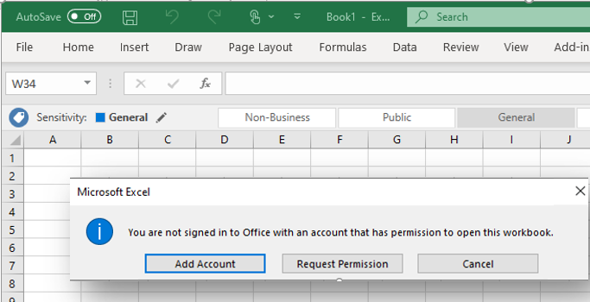
Label and Protect data exported from Power BI to files
Files exported from Power BI are protected according to sensitivity label policy, preventing access to sensitive data from unauthorized users

Slide 33
Large models in Power BI

Slide 34

Large models
Public preview coming soon
Large datasets in Premium
Key features
Power BI dataset cache size parity with Azure Analysis Services models
Limited only by Premium capacity size
Works on Premium P SKUs and Embedded A SKUs
Requires V2 workspaces
40X LARGER*
10 GB
400 GB
* Up to available memory on your capacity, excluding memory required for query execution and processing, which is often 20-30% of total memory.

Slide 35
XMLA Endpoints

Slide 36
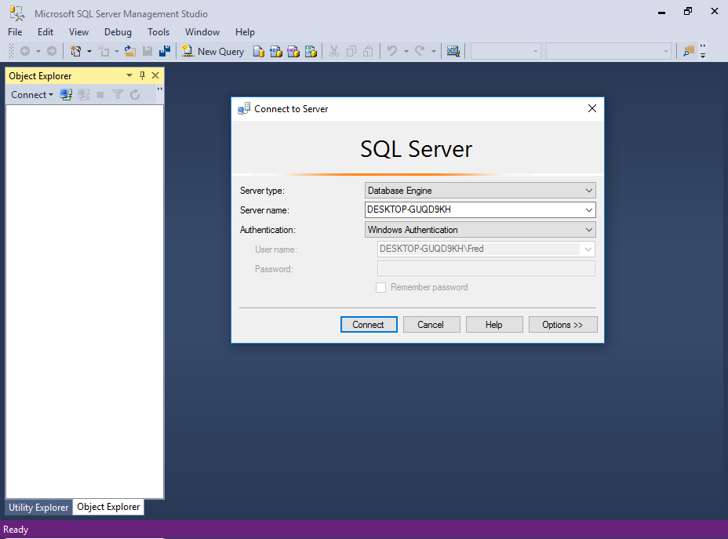
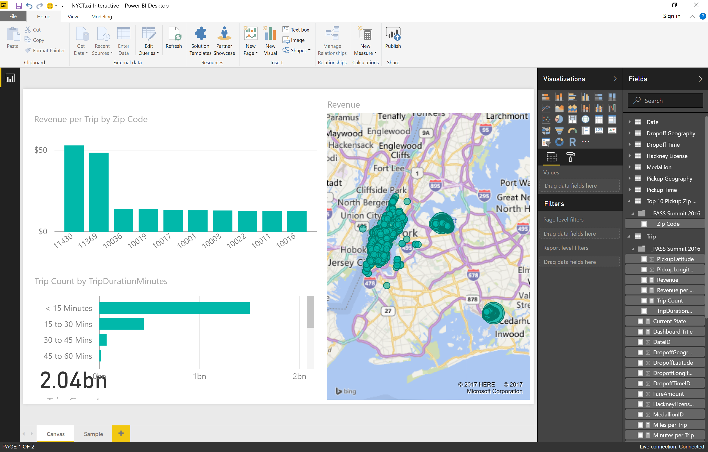
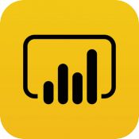
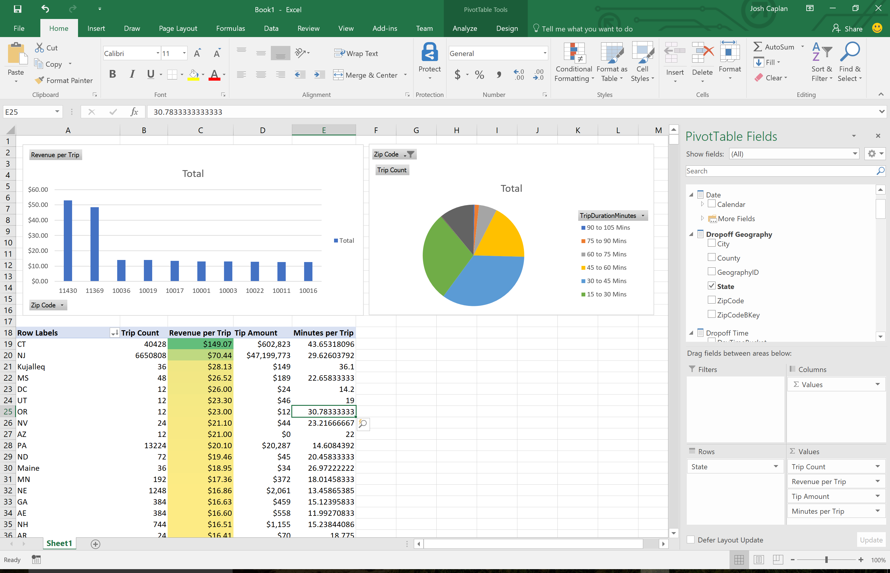
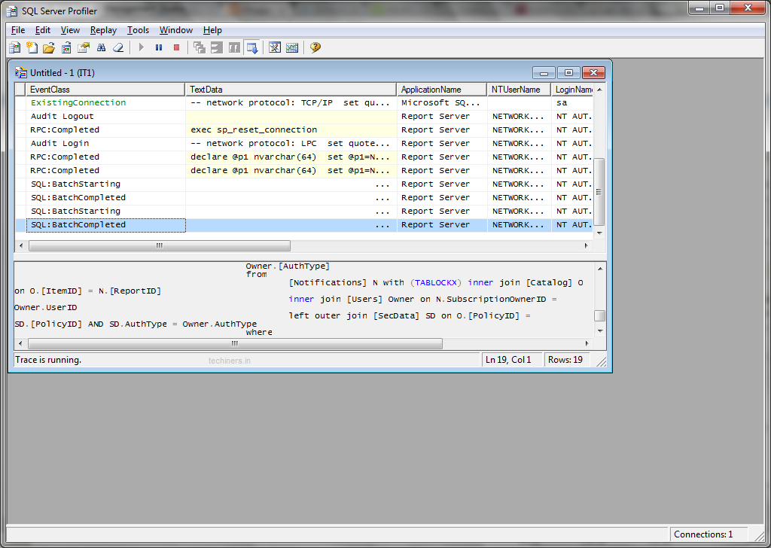

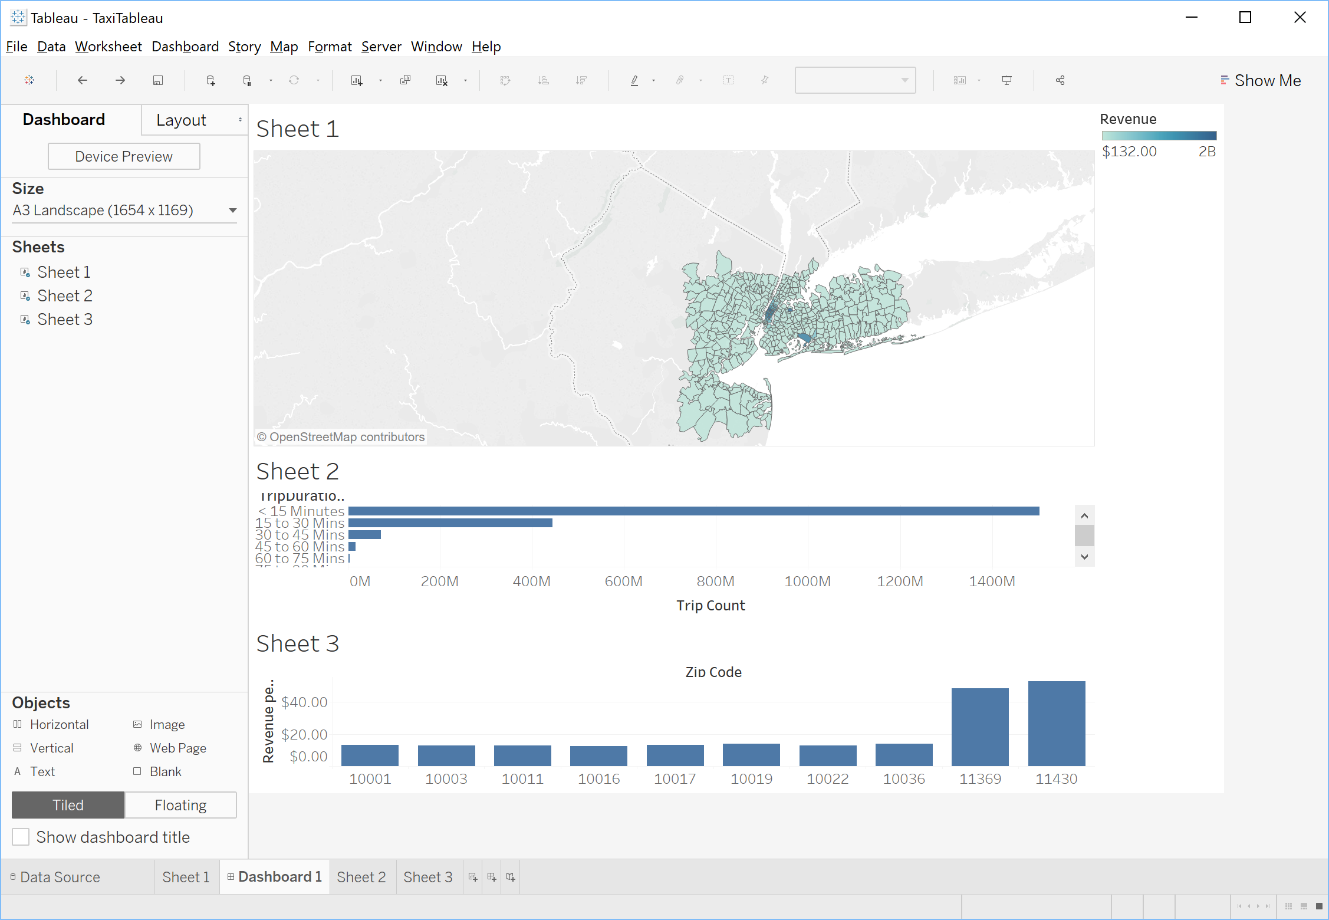
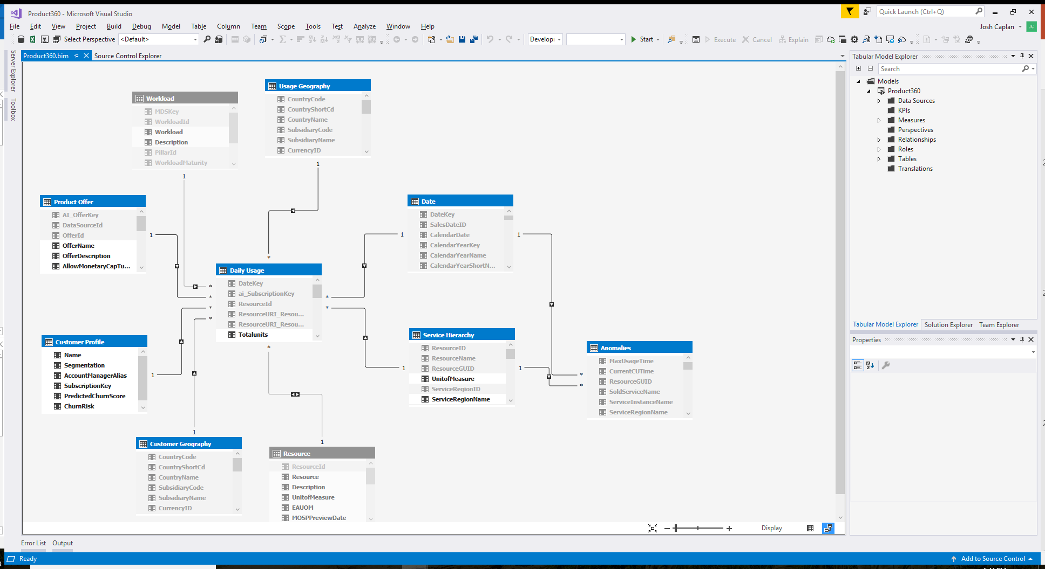
Connectivity: Analysis Services
Security
Data modeling
In-memory cache
Workspace
Lifecycle management
Business logic & metrics

Slide 37
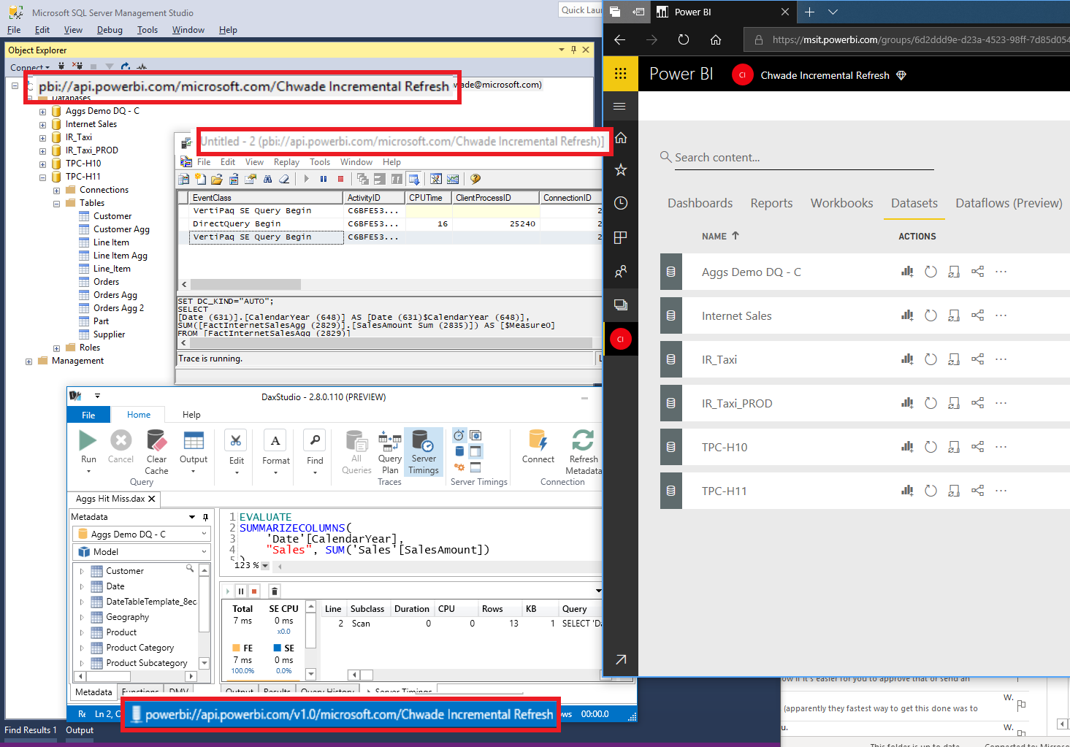

Slide 38
Power BI dataflows nyheder

Slide 39
Power BI dataflows nyheder
Enhanced Compute Engine (Preview)
Specielt ved joins - 25x
Direct Query via Dataflows (Low data Latency scenarier)
AI muligheder direkte i dataflows
AI Model tilgængelig som funktionskald
Mulighed for at bygge modeller (træne) via dataflow data.

Slide 40
Øvrige Power Platform

Slide 41
Øvrige Power Platform nyheder
Microsoft Flow -> Power Automate
UI Flows (RPA)
Power Virtual Agents
ALM Pipelines i Power BI
Opgrader Power BI Workspace fra v1 til v2
Decomposition Tree i Power BI
Bedre Teams og Power BI integration
Overview: https://www.moderndata.ai/2019/11/overview-of-ignite-2019/

